Slide 1
IQ River Crossing
Phuc Dang
Bogun Kim
CSC 4370

Slide 2
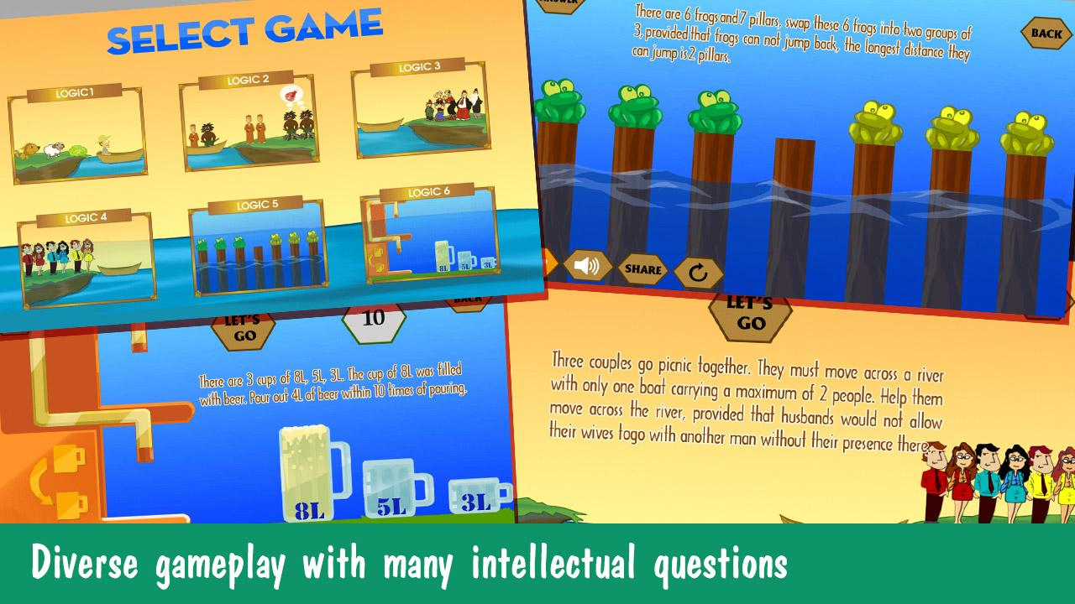
What is IQ River Crossing?
A type of logic game
The goal is to help the characters in the game crossing the river in the most optical way.

Slide 3
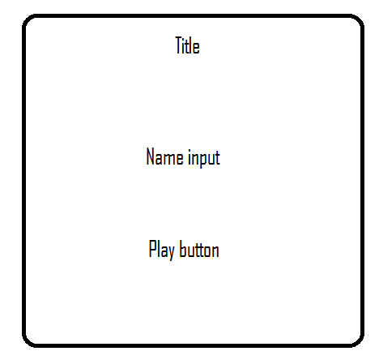
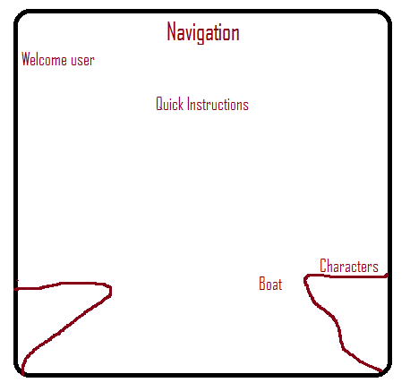
Design
Landing page -> playing page.

Slide 4
Challenges
Animation
Images positioning
Issue with session and post after resetting to new game

Slide 5
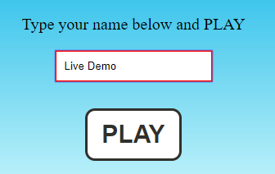


Features:
Session and post
Visibility with delay

Slide 6
Code Snippet
END GAME MESSAGE:
PHP: <div id="element" class="pretty">
<?php echo $_SESSION['n'] . " , You've done it!!! Congratulation!!" ?></div>
CSS:
#element{
-webkit-animation: 7s ease 0s normal forwards 1 fadein;
animation: 7s ease 0s normal forwards 1 fadein;
}
@keyframes fadein{
0% { opacity:0; }
66% { opacity:0; }
100% { opacity:1; }
}
@-webkit-keyframes fadein{
0% { opacity:0; }
66% { opacity:0; }
100% { opacity:1; }
}
Session and Post:
<form action="game1.php" method="post">
<p>Type your name below and PLAY</p>
<input id="box" type="text" name="name" /><br /><br />
<input id="playButton" type="submit" name="play" value="PLAY" /><br /><br />
<?php
echo "<h1> WELCOME, <span>" . $_SESSION['n']."</span></h1>";
?>

Slide 7
.sun{
width: 80px;
position: absolute;right: 0;
}
@keyframes fade {
0%,97% { opacity: 1 }
100% { opacity: 0 }
}
@keyframes cssAnimation {
to {
width:0;
height:0;
overflow:hidden;
}
}
@-webkit-keyframes cssAnimation {
to {
width:0;
height:0;
visibility:hidden;
}
}
/* Rules ends */
/* Buttons starts */
.buttonDIV{
display: flex;
justify-content: center;
}
.testbutton {
color: #FFFFFF !important;
font-size: 23px;
font-weight: bold;
text-shadow: 1px 1px 0px #DEC666;
box-shadow: 2px 2px 1px #F9D061;
padding: 9px 11px;
-webkit-border-radius: 10px;
border-radius: 10px;
border: 2px solid #FFFFFF;
background: #63B8EE;
background: linear-gradient(top, #EEA94F, #CFBA68);
background: -ms-linear-gradient(top, #EEA94F, #CFBA68);
background: -webkit-gradient(linear, left top, left bottom, from(#EEA94F), to(#CFBA68));
background: -moz-linear-gradient(top, #EEA94F, #CFBA68);
text-decoration: none;
}
.testbutton:hover {
color: #FFFFFF !important;
background: #468CCF;
background: linear-gradient(top, #CF1313, #EE3939);
background: -ms-linear-gradient(top, #CF1313, #EE3939);
background: -webkit-gradient(linear, left top, left bottom, from(#CF1313), to(#EE3939));
background: -moz-linear-gradient(top, #CF1313, #EE3939);
text-align:center;
}
/* Buttons ends */
/* Popupmenu starts */
.overlay {
position: fixed;
top: 0;
bottom: 0;
left: 0;
right: 0;
background: rgba(0, 0, 0, 0.7);
transition: opacity 500ms;
visibility: hidden;
opacity: 0;
}
.overlay:target {
visibility: visible;
opacity: 1;
}
.popupMenu {
margin: 70px auto;
padding: 20px;
background: #fff;
border-radius: 5px;
width: 30%;
position: relative;
transition: all 5s ease-in-out;
}
.popupMenu h2 {
margin-top: 0;
color: #333;
font-family: "Times New Roman", Georgia, Serif;
}
.popupMenu .close {
position: absolute;
top: 20px;
right: 30px;
transition: all 200ms;
font-size: 30px;
font-weight: bold;
text-decoration: none;
color: #333;
}
.popupMenu .close:hover {
color: #06D85F;
}
.popupMenu .content {
max-height: 30%;
overflow: auto;
}
@media screen and (max-width: 700px){
.container{
width: 70%;
}
.popupMenu{
width: 70%;
}
}
/* Popupmenu ends */
#hint{
font-weight:bold;
color: red;
}
span {
color:red;
text-transform: uppercase;
}
/* End game message! */
#element{
-webkit-animation: 7s ease 0s normal forwards 1 fadein;
animation: 7s ease 0s normal forwards 1 fadein;
}
@keyframes fadein{
0% { opacity:0; }
66% { opacity:0; }
100% { opacity:1; }
}
@-webkit-keyframes fadein{
0% { opacity:0; }
66% { opacity:0; }
100% { opacity:1; }
}
/* Additional styles not required */
.pretty {
background: pink;
color: green;
font-family: helvetica, arial, sans-serif;
padding: 40px 20px;
text-align: center;
width: auto;
text-transform: uppercase;
font-weight: bold;
font-size: 30px;
}
/* Popupmenu starts */
.overlay {
position: fixed;
top: 0;
bottom: 0;
left: 0;
right: 0;
background: rgba(0, 0, 0, 0.7);
transition: opacity 500ms;
visibility: hidden;
opacity: 0;
}
.overlay:target {
visibility: visible;
opacity: 1;
}
.popupMenu {
margin: 70px auto;
padding: 20px;
background: #fff;
border-radius: 5px;
width: 30%;
position: relative;
transition: all 5s ease-in-out;
}
.popupMenu h2 {
margin-top: 0;
color: #333;
font-family: "Times New Roman", Georgia, Serif;
}
.popupMenu .close {
position: absolute;
top: 20px;
right: 30px;
transition: all 200ms;
font-size: 30px;
font-weight: bold;
text-decoration: none;
color: #333;
}
.popupMenu .close:hover {
color: #06D85F;
}
.popupMenu .content {
max-height: 30%;
overflow: auto;
}
@media screen and (max-width: 700px){
.container{
width: 70%;
}
.popupMenu{
width: 70%;
}
}
/* Popupmenu ends */
#hint{
font-weight:bold;
color: red;
}
span {
color:red;
text-transform: uppercase;
}
/* End game message! */
#element{
-webkit-animation: 7s ease 0s normal forwards 1 fadein;
animation: 7s ease 0s normal forwards 1 fadein;
}
@keyframes fadein{
0% { opacity:0; }
66% { opacity:0; }
100% { opacity:1; }
}
@-webkit-keyframes fadein{
0% { opacity:0; }
66% { opacity:0; }
100% { opacity:1; }
}
/* Additional styles not required */
.pretty {
background: pink;
color: green;
font-family: helvetica, arial, sans-serif;
padding: 40px 20px;
text-align: center;
width: auto;
text-transform: uppercase;
font-weight: bold;
font-size: 30px;
}
body{
background: url(../images/bg.png)no-repeat center center fixed;
background-size: 100%;
background-size:cover;
}
@-webkit-keyframes mymove {
0% {right: 340px;}
80% {right:1000px;}
100% {right:1000px;}
}
@-webkit-keyframes sheepmove {
0% {right: 340px;}
80% {right:1000px;}
100% {right:1230px;}
}
.boat2{
width: 250px;
position:absolute; bottom: 190px; right: 340px; z-index: 1;
animation: mymove 5s;
animation-fill-mode: forwards;
}
.cabbage{
width: 130px;
position:absolute; bottom: 250px; right: 1450px; z-index: 1;
}
.sheep{
width: 120px;
position:absolute; bottom: 260px; right: 130px; z-index: 0;
animation: sheepmove 5s;
animation-fill-mode: forwards;
}
.wolf{
width: 200px;
position:absolute; bottom: 245px; right: 1300px; z-index: 1;
}
.img {
max-width:100%;
height:auto;
max-height:100%;
}
.sun{
width: 80px;
position: absolute;right: 0;
}
@keyframes fade {
0%,97% { opacity: 1 }
100% { opacity: 0 }
}
@keyframes cssAnimation {
to {
width:0;
height:0;
overflow:hidden;
}
}
@-webkit-keyframes cssAnimation {
to {
width:0;
height:0;
visibility:hidden;
}
}
/* Rules ends */
/* Buttons starts */
.buttonDIV{
display: flex;
justify-content: center;
}
.testbutton {
color: #FFFFFF !important;
font-size: 23px;
font-weight: bold;
text-shadow: 1px 1px 0px #DEC666;
box-shadow: 2px 2px 1px #F9D061;
padding: 9px 11px;
-webkit-border-radius: 10px;
border-radius: 10px;
border: 2px solid #FFFFFF;
background: #63B8EE;
background: linear-gradient(top, #EEA94F, #CFBA68);
background: -ms-linear-gradient(top, #EEA94F, #CFBA68);
background: -webkit-gradient(linear, left top, left bottom, from(#EEA94F), to(#CFBA68));
background: -moz-linear-gradient(top, #EEA94F, #CFBA68);
text-decoration: none;
}
.testbutton:hover {
color: #FFFFFF !important;
background: #468CCF;
background: linear-gradient(top, #CF1313, #EE3939);
background: -ms-linear-gradient(top, #CF1313, #EE3939);
background: -webkit-gradient(linear, left top, left bottom, from(#CF1313), to(#EE3939));
background: -moz-linear-gradient(top, #CF1313, #EE3939);
text-align:center;
}
/* Buttons ends */
/* Popupmenu starts */
.overlay {
position: fixed;
top: 0;
bottom: 0;
left: 0;
right: 0;
background: rgba(0, 0, 0, 0.7);
transition: opacity 500ms;
visibility: hidden;
opacity: 0;
}
.overlay:target {
visibility: visible;
opacity: 1;
}
.popupMenu {
margin: 70px auto;
padding: 20px;
background: #fff;
border-radius: 5px;
width: 30%;
position: relative;
transition: all 5s ease-in-out;
}
.popupMenu h2 {
margin-top: 0;
color: #333;
font-family: "Times New Roman", Georgia, Serif;
}
.popupMenu .close {
position: absolute;
top: 20px;
right: 30px;
transition: all 200ms;
font-size: 30px;
font-weight: bold;
text-decoration: none;
color: #333;
}
.popupMenu .close:hover {
color: #06D85F;
}
.popupMenu .content {
max-height: 30%;
overflow: auto;
}
@media screen and (max-width: 700px){
.container{
width: 70%;
}
.popupMenu{
width: 70%;
}
}
/* Popupmenu ends */
#hint{
font-weight:bold;
color: red;
}
span {
color:red;
text-transform: uppercase;
}
/* End game message! */
#element{
-webkit-animation: 7s ease 0s normal forwards 1 fadein;
animation: 7s ease 0s normal forwards 1 fadein;
}
@keyframes fadein{
0% { opacity:0; }
66% { opacity:0; }
100% { opacity:1; }
}
@-webkit-keyframes fadein{
0% { opacity:0; }
66% { opacity:0; }
100% { opacity:1; }
}
/* Additional styles not required */
.pretty {
background: pink;
color: green;
font-family: helvetica, arial, sans-serif;
padding: 40px 20px;
text-align: center;
width: auto;
text-transform: uppercase;
font-weight: bold;
font-size: 30px;
}
.popupMenu .content {
max-height: 30%;
overflow: auto;
}
@media screen and (max-width: 700px){
.container{
width: 70%;
}
.popupMenu{
width: 70%;
}
}
/* Popupmenu ends */
#hint{
font-weight:bold;
color: red;
}
span {
color:red;
text-transform: uppercase;
}
/* End game message! */
#element{
-webkit-animation: 7s ease 0s normal forwards
1 fadein;
animation: 7s ease 0s normal forwards 1
fadein;
}
@keyframes fadein{
0% { opacity:0; }
66% { opacity:0; }
100% { opacity:1; }
}
@-webkit-keyframes fadein{
0% { opacity:0; }
66% { opacity:0; }
100% { opacity:1; }
}

Slide 8
Live Demo
http://codd.cs.gsu.edu/~pdang2/Project2/start.html

